Slide 1
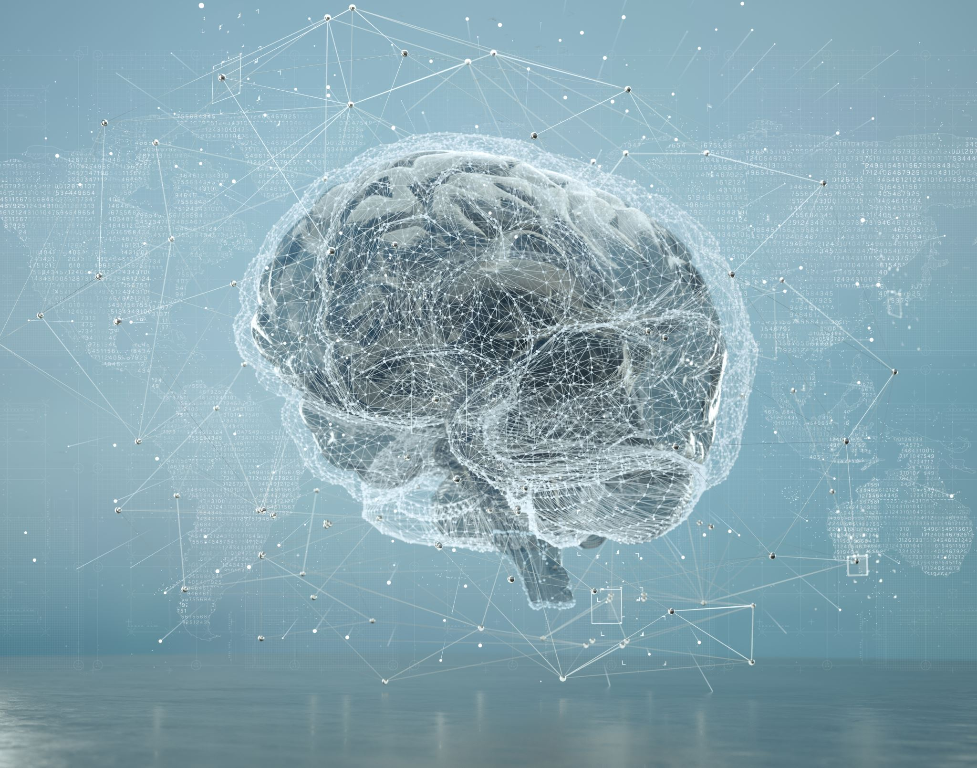
ITS ROOTS AND SCOPE
PART-I
Artificial Intelligence:
Instructor : GUL E ARZOO

Slide 2
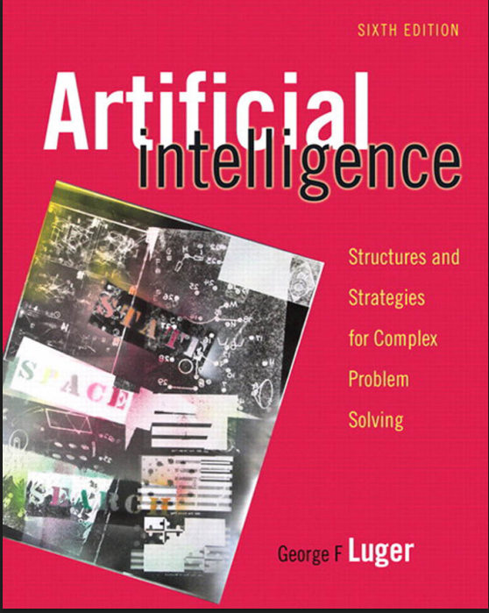
Chapter 1: What We Will Cover
Textbook: Artificial Intelligence by George F. Luger
1. Philosophical Roots & History
Rationalism vs. Empiricism, formal logic, and the Turing Test.
2. Key AI Application Domains
Game playing, expert systems, NLU, robotics, and machine learning.
3. Bio-AI & Core Characteristics
Neural networks, genetic algorithms, and the 8 unifying features of AI.

Slide 3
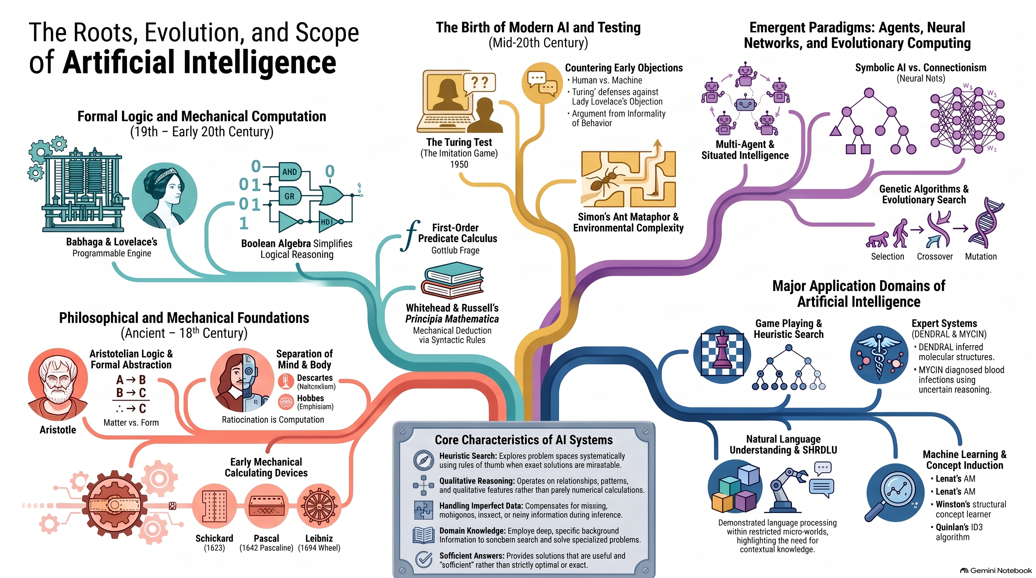

Slide 4
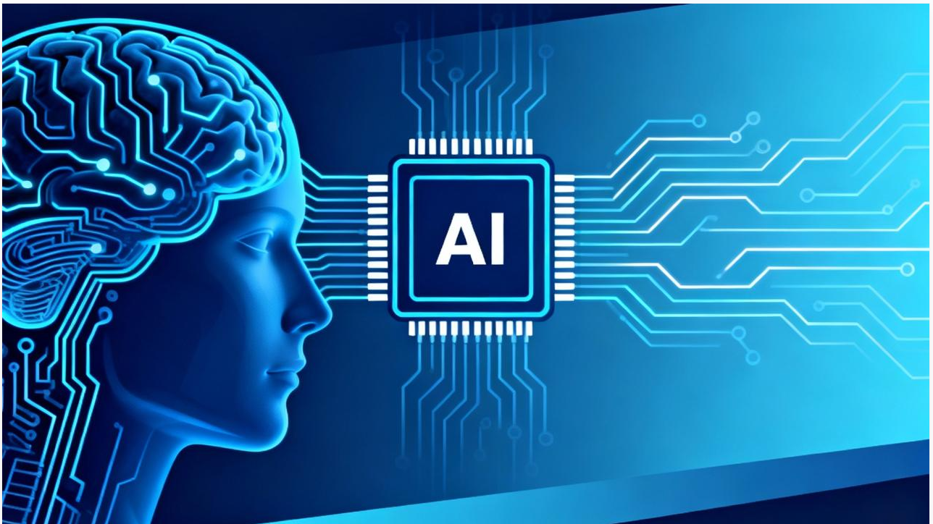
Artificial Intelligence: An Attempted Definition
DEFINITION
Artificial Intelligence (AI) is a branch of computer science concerned with the automation of intelligent behavior.
AI as a Branch of Computer Science
AI is built on three fundamental foundations:
Knowledge Representation: Structures used to store and organize knowledge.
Algorithms: Procedures used to process knowledge and solve problems.
Programming Languages and Techniques: Tools used to implement intelligent systems.
Examples of AI Applications
Language understanding
Automated mathematical theorem proving
Medical diagnosis and prediction
Visualization of gene expression data

Slide 5
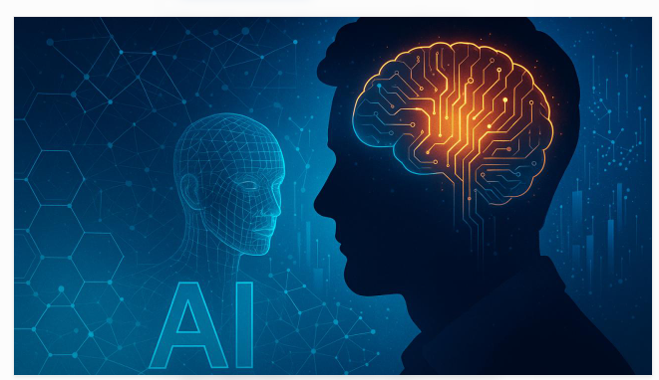
Artificial Intelligence: An Attempted Definition (Challenges in Defining Artificial Intelligence)
Why Is AI Difficult to Define?
Intelligence itself is not fully understood. Researchers continue to investigate fundamental questions:
Nature of Intelligence: Is intelligence one ability or a combination of different abilities?
Learning: How do humans acquire knowledge, and how does learning occur?
Creativity and Intuition: Can computers demonstrate creativity and intuitive reasoning?
Knowledge Representation: How is knowledge represented in the human brain?
Human vs. Machine Intelligence: Must AI imitate human intelligence, or can machines use different approaches?
The Engineering Approach
Instead of solving the entire problem of general intelligence, researchers often develop specialized intelligent systems, such as diagnostic tools, prediction systems, and automated reasoning applications.
A Practical Definition
AI can be understood as the collection of problems and methodologies studied by AI researchers.

Slide 6
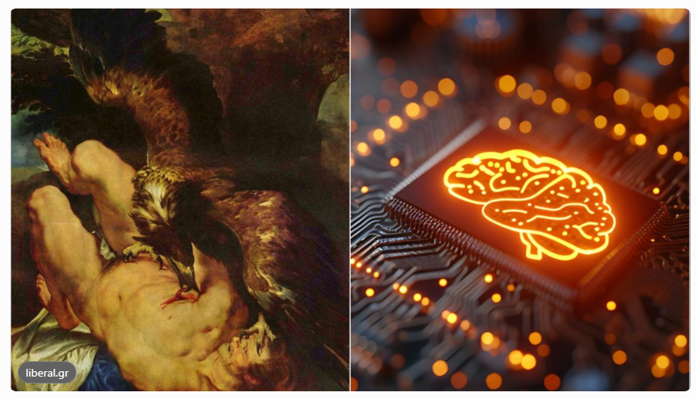
AI: EARLY HISTORY AND APPLICATIONS
1. Historical Roots of Artificial Intelligence
Prometheus: In Greek mythology, Prometheus gave humanity fire and knowledge, symbolizing the power of intelligence and technological progress.
The Quest for Knowledge: Stories such as Eden and Prometheus reflect historical fears that pursuing knowledge may have dangerous consequences.
Mary Shelley's Frankenstein (1818): Explored the possibility of creating life through scientific knowledge, experimentation, and electricity.
2. From Mythology to Scientific Thinking
Scientific discoveries encouraged people to believe that the mysteries of life and intelligence could be studied systematically.
Nature and intelligence increasingly became subjects of scientific investigation rather than matters beyond human understanding.
Although nineteenth-century science could not create a fully intelligent agent, it helped establish the foundations for future AI research.
Conclusion :
Artificial Intelligence emerged from humanity's long-standing desire to understand intelligence, acquire knowledge, and develop machines capable of intelligent behavior.

Slide 7
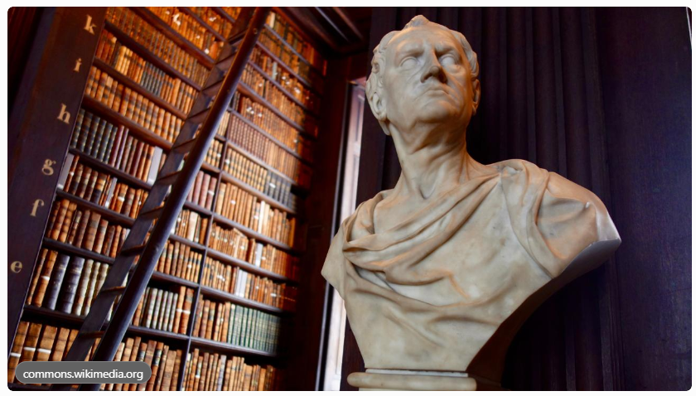
Aristotle — The Philosophical Foundations of AI: A Brief History of the Foundations for AI
1. Aristotle and the Study of Knowledge
Aristotle explored how humans understand the world and how knowledge can be established through logical reasoning.
Matter and Form: He distinguished the material of an object from its form or structure. This distinction provides a philosophical connection to symbolic computing and data abstraction.
Logic and Reasoning: Aristotle studied how conclusions can be derived from known facts using logical relationships.
Example of Deductive Reasoning
Premise 1: All humans are mortal.
Premise 2: Socrates is a human.
Conclusion: Socrates is mortal.
Relevance to AI: Logical reasoning and the representation of knowledge are fundamental ideas behind symbolic AI and automated reasoning systems.

Slide 8
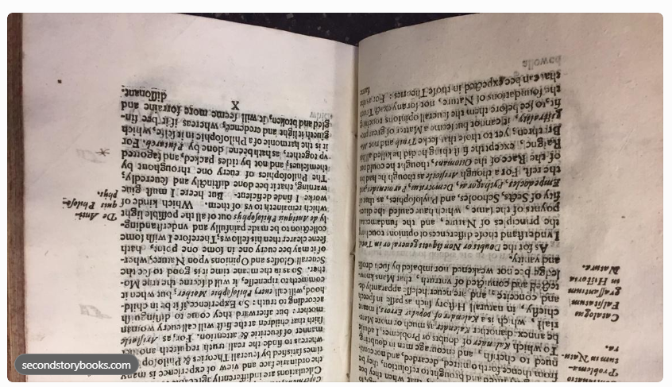
A Brief History of the Foundations for AI (Scientific Method and Concept Learning)
2. From Philosophy to Scientific Investigation
Renaissance: Science increasingly became a systematic way to understand natural phenomena through observation, mathematics, and analysis.
Copernicus and Galileo: Their work demonstrated that appearances and traditional beliefs could differ from scientific explanations of the world.
Francis Bacon (1620): In Novum Organum, Bacon described a systematic approach to identifying the essential features of a concept by examining positive and negative examples.
Bacon’s Approach to Concept Learning
Collect examples of the concept.
Identify and record their features.
Examine negative examples, particularly those that differ in only a few features.
Determine which features distinguish the concept from other cases.
Connection to Modern AI: Luger relates Bacon’s approach to concept learning methods such as Version Space Search and to the BACON program, which induced scientific laws from data.
Notes:
Renaissance (daur-e-jadid)

Slide 9
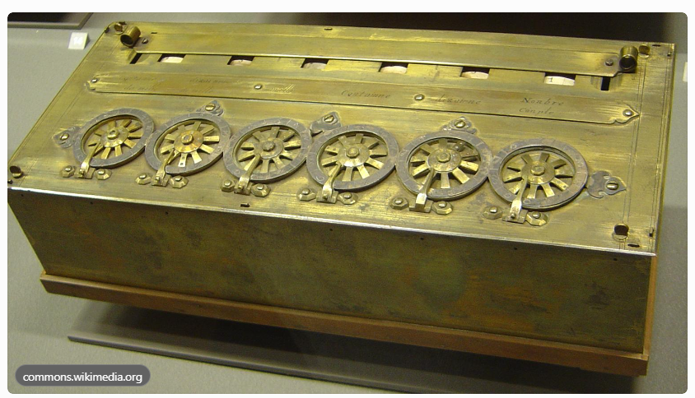
A Brief History of the Foundations for AI (Early Computing Machines and the Nature of Mind)
3. Mechanizing Calculation and Reasoning
John Napier (1614): Developed logarithms that simplified mathematical calculations.
Wilhelm Schickard (1623): Designed a calculating clock for addition and subtraction.
Blaise Pascal (1642): Created the Pascaline, a mechanical calculator for arithmetic operations.
Gottfried Wilhelm Leibniz (1694): Developed a calculating machine capable of multiplication and division and envisioned mechanized logical reasoning.
René Descartes and Thomas Hobbes
Descartes explored the relationship between the mind and the physical world, raising questions about the nature of thought.
Hobbes proposed a computational view of reasoning, connecting thought with calculation.
Relevance to AI
These developments established two important ideas:
Some processes traditionally requiring human skill can be automated.
Reasoning may be studied through formal systems and computational procedures.

Slide 10

How did the development of logical reasoning, scientific methods, and mechanical calculators contribute to the idea that computers could perform intelligent tasks?
Suggested classroom discussion:
Notes:
Slide 10: Rationalism vs. Empiricism
Speaker Notes:
Opening: "Yeh slide aap ke exam aur concepts dono ke liye bohot important hai: Rationalism vs Empiricism."
Core Explanation:
"Rationalist (Plato, Descartes) kehte hain ke ilm (knowledge) pure logic aur mathematics se aata hai. Classical Rule-Based AI is par bani hai."
"Empiricists (Aristotle, Hume) kehte hain ke ilm sensory experience aur observation se aata hai. Modern Machine Learning aur Neural Networks is par bane hain kyun ke wo data dekh kar sikhte hain."
Class Interaction: "Aap ke khayal mein insani bacha kaise sikhta hai? Logic se ya tajurbe (experience) se?"

Slide 11
AI and the Rationalist and Empiricist Traditions
1. Rationalist Tradition
Key idea: Knowledge about the external world can be reconstructed through reason, logic, mathematics, and clear ideas.
Key philosophers: Plato, Pascal, Descartes, and Leibniz.
AI application: Early robot-planning systems represented the world using predicate calculus statements and generated plans by proving logical theorems.
Related concept: Newell and Simon’s Physical Symbol System Hypothesis.
Limitation: Symbols and logical representations may fail to capture the complexity of the real world, contributing to difficulties in tasks such as natural language understanding.
2. Empiricist Tradition
Key idea: Knowledge originates through sensory experience and observation of the external world.
Key philosophers: Aristotle, Thomas Hobbes, John Locke, and David Hume.
Associationism: Repeated experiences create associations between perceptions and ideas.
Hume’s distinction: Impressions are vivid perceptions, while ideas are less vivid mental representations.
AI applications: Machine learning, semantic networks, natural language understanding, and connectionist networks.
Key distinction: Rationalism emphasizes reason and logical representation, whereas empiricism emphasizes experience, perception, and learning through associations.

Slide 12
AI and the Rationalist and Empiricist Traditions
3. Bayes and the Mathematical Treatment of Uncertainty
Reverend Thomas Bayes developed a mathematical approach to reasoning about probability.
Bayes’ theorem provides a formal way to update the probability of a cause given observed evidence.
AI applications: Bayesian belief networks, medical diagnosis, machine learning, and natural language understanding.
4. Immanuel Kant: A Synthesis of Both Traditions
Kant was influenced by both the rationalist tradition and David Hume’s empiricism.
A priori knowledge: Knowledge contributed by reason, independently of particular experiences.
A posteriori knowledge: Knowledge derived from experience.
Kant argued that knowledge requires both sensory experience and the mind’s active organization of that experience.
His ideas influenced cognitive psychology, constructivist epistemology, and modern AI research.
5. Relevance to Modern Artificial Intelligence
Rationalist approach: Symbolic reasoning, logic-based planning, and knowledge representation.
Empiricist approach: Machine learning, association-based learning, and probabilistic inference.
Combined perspective: Intelligent systems can use structured reasoning while learning from observed data and experience.
Key takeaway: The rationalist and empiricist traditions provide complementary foundations for understanding how AI systems represent knowledge, reason, and learn.

Slide 13
AI: History and Applications
(1.1.3 The Development of Formal Logic)
Calculus Philosophicus & Graph Theory:
  Gottfried Wilhelm von Leibniz (1887): Introduced Calculus Philosophicus—the first system of formal logic and proposed a machine for automating its tasks.
  Leonhard Euler (1735): Analyzed the "Bridges of Königsberg" problem, introducing Graph Theory to abstractly represent relationships and discrete steps in computation.
State Space Search in AI:
  Nodes: Represent possible stages of a problem solution.
  Arcs: Represent inferences, moves in a game, or other steps in a problem solution.
  State Space Graphs: Provide a tool for measuring problem structure/complexity and analyzing solution efficiency, correctness, and generality.

Slide 14
AI: History and Applications
(1.1.3 The Development of Formal Logic)
Charles Babbage (1791–1871):
  Designed the Difference Engine (special-purpose for polynomial functions) and Analytical Engine (general-purpose programmable machine).
  Presaged modern computer architecture: separation of memory ("store") and processor ("mill"), digital operation, and programmability using punched cards.
Ada Lovelace (1815–1852) & Symbol Abstraction:
  "The Analytical Engine weaves algebraical patterns just as the Jacquard loom weaves flowers and leaves."
  Highlighted the treatment of algebraic patterns as entities that can be mechanically manipulated without concern for particular numerical values (Aristotle & Leibniz's "abstraction and manipulation of form").

Slide 15
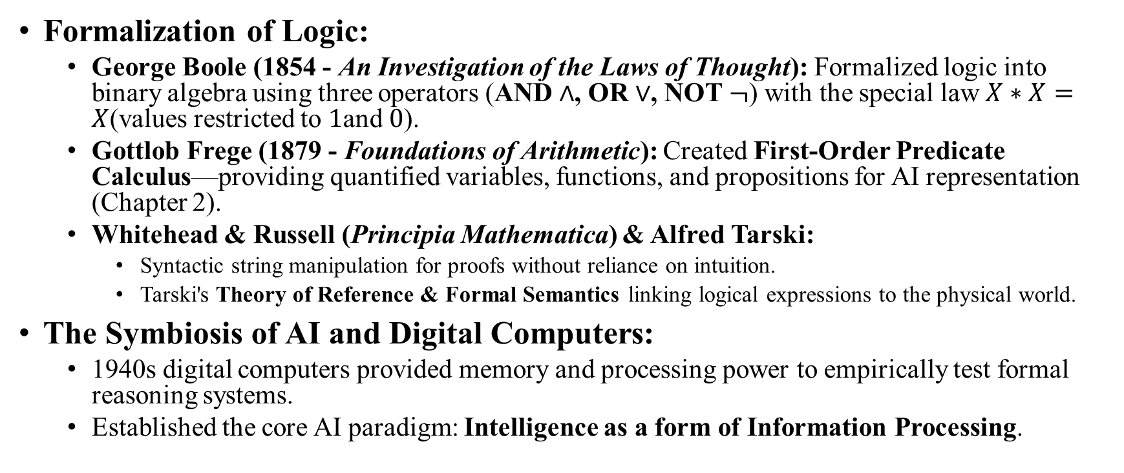
AI: History and Applications
(1.1.3 The Development of Formal Logic)
Formalization of Logic:
  George Boole (1854 - An Investigation of the Laws of Thought): Formalized logic into binary algebra using three operators (AND $∧$, OR $∨$, NOT $¬$) with the special law $X∗X=X$(values restricted to $1$and $0$).
  Gottlob Frege (1879 - Foundations of Arithmetic): Created First-Order Predicate Calculus—providing quantified variables, functions, and propositions for AI representation (Chapter 2).
  Whitehead & Russell (Principia Mathematica) & Alfred Tarski:
    Syntactic string manipulation for proofs without reliance on intuition.
    Tarski's Theory of Reference & Formal Semantics linking logical expressions to the physical world.
The Symbiosis of AI and Digital Computers:
  1940s digital computers provided memory and processing power to empirically test formal reasoning systems.
  Established the core AI paradigm: Intelligence as a form of Information Processing.

Slide 16
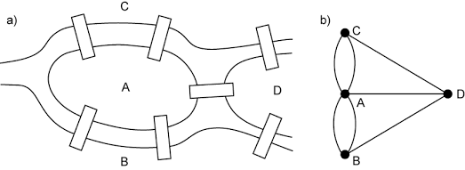
From Eden to ENIAC: Attitudes toward Intelligence, Knowledge, and Human Artifice Prometheus speaks of the fruits of his transgression against the gods of Olympus

Slide 17
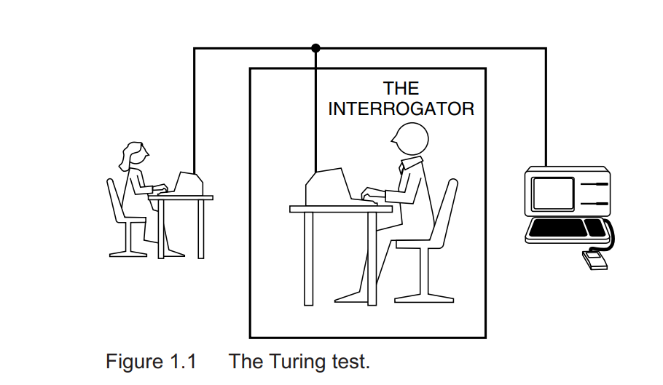
The Turing Test

Slide 18
The Turing Test(The Imitation Game)
Empirical Test of Intelligence:
  Proposed by Alan Turing (1950) in "Computing Machinery and Intelligence".
  Replaced ambiguous questions ("Can machines think?") with a practical, empirical evaluation.
The Imitation Game Setup:
  Participants: Human Interrogator, Human Subject, and Machine (placed in separate rooms).
  Interface: Solely text-based communication (e.g., terminal/chat) to prevent physical bias.
  Core Criteria: If the interrogator cannot distinguish the computer from the human based on its responses, the machine is deemed intelligent.
Features:
  Objective Standard: Evaluates behavior in response to questions without philosophical debate over "true" thinking.
  Bypasses Internal Debates: Avoids questions regarding consciousness or internal brain-like processes.
  Eliminates Physical Bias: Directs focus strictly on answer content rather than appearance or voice.

Slide 19
The Turing Test (Practical Evaluation & Major Criticisms
Application in Modern AI:
  Serves as a foundation for evaluating Expert Systems through blind performance comparisons against human experts.
Major Criticisms & Vulnerabilities:
  Symbolic Bias: Focuses exclusively on text/symbolic processing; neglects perceptual skills and physical/manual dexterity (robotics).
  Human-Centric Constraint: Unnecessarily forces machine intelligence into a human mold (e.g., requiring machines to intentionally make arithmetic errors to appear human).
  Distraction from Core Science (Ford & Hayes, 1995): Chasing the imitation game can distract researchers from developing general theories of intelligence and practical problem-solving tools.

Slide 20
The Turing Test (Philosophical Objections & Behavioral Complexity)
Countering Historical Objections:
  Lady Lovelace’s Objection:
    Objection: Computers can only do what they are programmed to do (cannot be original).
    AI Counter: Diagnostic Expert Systems frequently reach conclusions unanticipated by their designers.
  Argument from Informality of Behavior:
    Objection: Formal rules cannot prescribe action for every possible real-world scenario.
    AI Counter: Flexible architectures (production systems, pattern matchers, neural networks) allow small rule sets to handle dynamic situations.
Herbert Simon’s Ant Architecture (The Sciences of the Artificial, 1981):
  An ant’s path seems complex, but its internal rules are simple; the complexity arises from its environment.
  AI Insight: Complex intelligent behavior often emerges from simple mechanisms interacting with a rich, complex environment/culture.

Slide 21
Biological and Social Models of Intelligence: Agents Theories
Philosophical Critique of Rationalism.
Critique of GOFAI (Good Old Fashioned AI):
  Traditional AI assumes intelligence is purely logical reasoning and symbolic manipulation (rationalist tradition: Plato, Descartes, Leibniz, Turing).
  Ignores the physical, social, and cultural context in which intelligence develops.
Key Philosophical Foundations:
  Ludwig Wittgenstein (1953): Meaning in language is not objective; it is situated in a human and cultural context (e.g., the physical and cultural definition of a "chair").
  Husserl & Heidegger (Phenomenology): Defined intelligence as knowing how to cope and survive in a dynamic world (Lebenswelt), rather than storing abstract logical propositions.

Slide 22
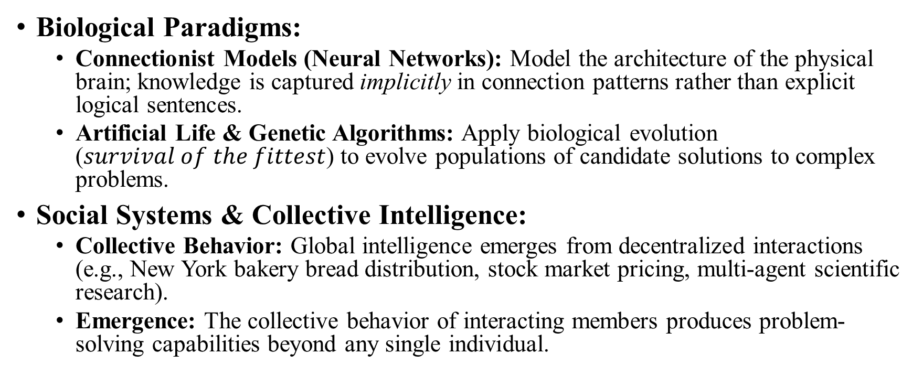
Biological and Social Models of Intelligence: Agents Theories (Connectionist, Evolutionary & Social Models)
Biological Paradigms:
  Connectionist Models (Neural Networks): Model the architecture of the physical brain; knowledge is captured implicitly in connection patterns rather than explicit logical sentences.
  Artificial Life & Genetic Algorithms: Apply biological evolution ($survival of the fittest$) to evolve populations of candidate solutions to complex problems.
Social Systems & Collective Intelligence:
  Collective Behavior: Global intelligence emerges from decentralized interactions (e.g., New York bakery bread distribution, stock market pricing, multi-agent scientific research).
  Emergence: The collective behavior of interacting members produces problem-solving capabilities beyond any single individual.

Slide 23
Biological and Social Models of Intelligence: Agents Theories (Agent Characteristics & Architecture)
5 Main Themes of Intelligent Agents:
  Autonomous / Semi-autonomous: Independent problem-solving with localized responsibilities.
  Situated: Sensitive to its local environment with limited global knowledge.
  Interactional: Cooperate as a "society" with distributed knowledge and skills.
  Structured: Coordinated interactions to achieve collective problem solving.
  Emergent: System intelligence is greater than the sum of its individual agent parts.
Agent Types: Rote, Coordination, Search, Learning, and Decision Agents.
Requisites for Building Agent Societies:
  Structures for information representation.
  Strategies for searching alternative solutions.
  Architectures supporting agent interaction.

Slide 24
Overview of AI Application Areas
AI Core Foundations & Game Playing
Two Fundamental Concerns of AI:
  Knowledge Representation (Chapter 2): Capturing the full range of qualitative knowledge in a computer-manipulable language (e.g., Predicate Calculus, Commonsense Reasoning).
  Search (Chapters 3 & 4): Systematically exploring a space of problem states (alternative moves or intermediate reasoning steps).
    Newell & Simon (1976): Search is the essential basis of human problem solving (e.g., chess moves, medical diagnoses).
Section 1.2.1: Game Playing:
  Why Games as AI Research Testbeds?
    Well-defined Rules: Easy to generate search spaces without real-world ambiguities.
    Simple Representation: Board configurations map directly onto computers.
    Safe & Ethical: No financial or ethical risk during testing.
  Heuristics in Game Search:
    Definition: Useful, practical, but potentially fallible problem-solving strategies (e.g., castling to protect the king in chess).
    Role: Helps navigate extremely large, complex state spaces by focusing on the most promising moves.
  Milestones in Game AI:
    World championship successes in Backgammon and Chess.
    Checkers (2007): Full state space mapped out, making the game completely solved and deterministic from move one!

Slide 25
Automated Reasoning and Theorem Proving
Historical Significance & Foundations:
  Oldest Branch of AI: Roots trace back to Leibniz, Babbage, Russell & Whitehead, and Newell & Simon’s Logic Theorist & General Problem Solver (GPS).
  Key Contributions: Driven early development in Search Algorithms, Predicate Calculus, and logic programming languages like Prolog.
Why Use Formal Logic?
  Rigor & Generality: Logic is a formal system, making it ideal for computer automation.
  Problem Solving Strategy: Problems are represented as logical axioms, and solutions are derived as theorems to be proved.
Early Challenges & Solution Evolution:
  Combinatorial Explosion: Early theorem provers generated infinite irrelevant theorems due to huge search spaces without guidance.
  Syntactic Heuristics: Modern systems use powerful heuristics based on logical syntax to search efficiently without relying solely on ad-hoc human tricks.
Practical Applications & Modern Role:
  Key Applications: Hardware design verification, software program verification, and complex system control.
  Intelligent Assistants (Human-AI Collaboration):
    Human Role: Decomposes large problems and guides overall proof strategy.
    Automated Prover Role: Verifies lemmas, sub-proofs, and formal mechanical steps (e.g., Boyer-Moore, Bundy).

Slide 26
Expert Systems
Core Insight & Architecture:
  Domain-Specific Knowledge: High performance requires deep domain knowledge (theory + heuristics) rather than general problem-solving alone.
  Knowledge Engineering: Developed through collaboration between a Domain Expert (physician, geologist) and a Knowledge Engineer (AI specialist).
  Iterative Refinement: Program behavior is continuously evaluated and modified by experts using sample problems.
Pioneering Expert Systems:
  DENDRAL (Late 1960s): Inferred organic molecular structures; pruned massive search spaces using organic chemistry heuristics.
  MYCIN (Mid-1970s): Diagnosed blood infections and meningitis; established standard methodology (reasoning under uncertainty, explanation facilities).
  PROSPECTOR & XCON (1980s): PROSPECTOR located mineral deposits; XCON configured DEC VAX computer architectures.
Key Limitations & Deficiencies:
  Lack of Deep Knowledge: Relies on surface-level rules (e.g., MYCIN lacks underlying human physiology models).
  Lack of Robustness: Cannot fall back on "first principles" when encountering novel problems outside its rule set.
  Shallow Explanations: Restricted to tracing executed rule steps rather than explaining fundamental underlying principles.
  Verification Challenges: Hard to formally verify correctness in critical systems (e.g., medical diagnosis, aviation).
  Static Performance: Limited learning from experience without manual updates by knowledge engineers.

Slide 27
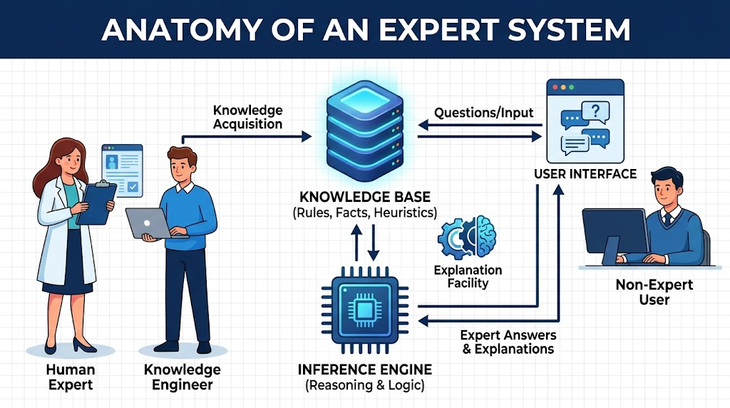
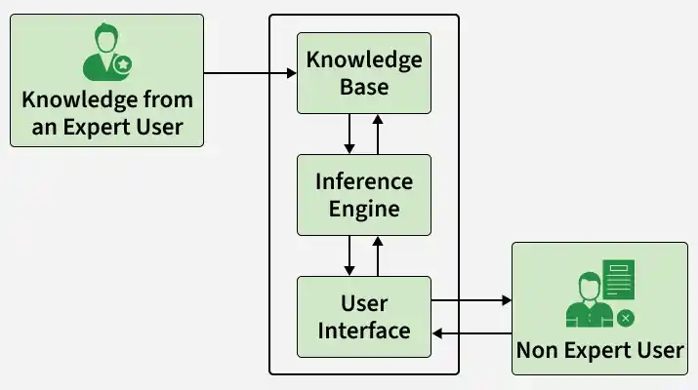

Slide 28
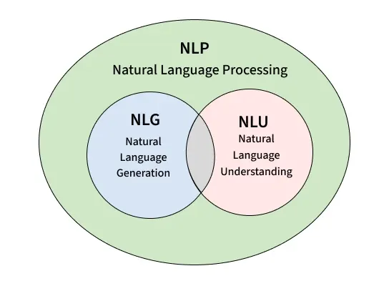
Natural Language Understanding and Semantics

Slide 29
Natural Language Understanding and Semantics
Core Objective & Challenge
  Goal: Creating programs capable of understanding and generating human language to enhance human-computer interaction.
  Current Reality: Highly successful in restricted/constrained domains, but broad human-like flexibility remains an open challenge in AI.
Beyond Syntax: The Role of Context & Domain Knowledge
  True comprehension requires much more than grammatical parsing and dictionary lookups.
  Depends on background knowledge, idioms, and contextual reasoning to resolve ambiguity and omissions in speech.
  Textbook Example: "With none down in the top of the ninth and the go-ahead run at second..." (Meaningless without domain knowledge of baseball rules).
Micro-World Methodology (SHRDLU)
  Winograd’s SHRDLU (1973): Conversed, answered queries, and planned actions within a constrained "Blocks World" (manipulating colored cubes and pyramids).
  Limitation: Simple representational techniques could not generalize or scale to complex real-world domains.
Modern NLU Techniques & Current Status
  Semantic Representation: Modern systems extend Semantic Networks to structure domain-specific knowledge.
  Stochastic Models: Uses statistical/probabilistic models to analyze word occurrences, syntax, and usage patterns.
  Takeaway: Full computational understanding of natural language remains an active area of research.

Slide 30
Modeling Human Performance
1. Performance vs. Simulation in AI
Goal-Oriented Engineering: Most AI systems focus on solving complex problems effectively rather than duplicating human internal mental processes.
Non-Human Strategies: When performance is the main criterion, non-human approaches often outperform human methods.
  Real-World Example: DeepMind’s AlphaZero / Stockfish evaluate millions of positions per second using pure search and neural network evaluations—radically different from how human grandmasters think.
2. Computational Metaphor for Cognitive Psychology
A New Theoretical Vocabulary: Computer science provides psychologists with a precise framework to formulate models of human thought.
Overcoming Behaviorism: Replaces vague early psychological descriptions and moves past strict behaviorism by treating the human mind as an information-processing system.
3. Empirical Testing & Cognitive Science
Executable Theories: Implementing cognitive models as software allows researchers to empirically test, critique, and refine theories of human intelligence.
Bridge to Cognitive Science: Connects AI and Cognitive Psychology to explore mental architecture.
4. Modern AI Connection (2026 Perspective)
Cognitive Architectures (e.g., ACT-R, SOAR): Used today to simulate human pilot fatigue or driver reaction times in safety testing.
LLMs vs. Human Cognition: Models like GPT-4o or Claude 3.5 show high performance on reasoning tasks, yet cognitive scientists actively debate whether their internal mechanisms mirror human mental models or remain statistical pattern matchers.

Slide 31
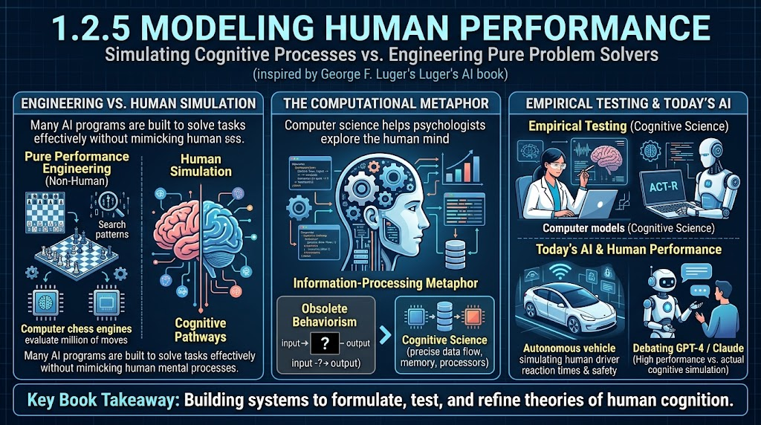
Modeling Human Performance

Slide 32
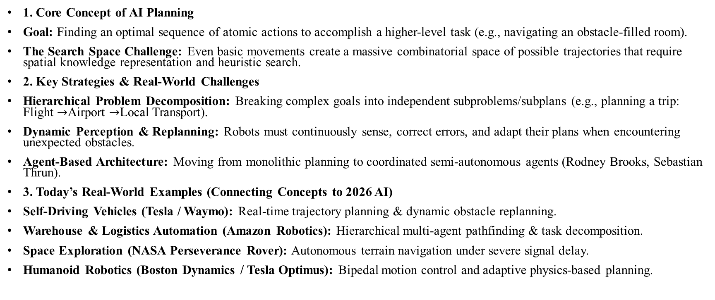
Planning and Robotics
1. Core Concept of AI Planning
Goal: Finding an optimal sequence of atomic actions to accomplish a higher-level task (e.g., navigating an obstacle-filled room).
The Search Space Challenge: Even basic movements create a massive combinatorial space of possible trajectories that require spatial knowledge representation and heuristic search.
2. Key Strategies & Real-World Challenges
Hierarchical Problem Decomposition: Breaking complex goals into independent subproblems/subplans (e.g., planning a trip: Flight $→$Airport $→$Local Transport).
Dynamic Perception & Replanning: Robots must continuously sense, correct errors, and adapt their plans when encountering unexpected obstacles.
Agent-Based Architecture: Moving from monolithic planning to coordinated semi-autonomous agents (Rodney Brooks, Sebastian Thrun).
3. Today’s Real-World Examples (Connecting Concepts to 2026 AI)
Self-Driving Vehicles (Tesla / Waymo): Real-time trajectory planning & dynamic obstacle replanning.
Warehouse & Logistics Automation (Amazon Robotics): Hierarchical multi-agent pathfinding & task decomposition.
Space Exploration (NASA Perseverance Rover): Autonomous terrain navigation under severe signal delay.
Humanoid Robotics (Boston Dynamics / Tesla Optimus): Bipedal motion control and adaptive physics-based planning.

Slide 33
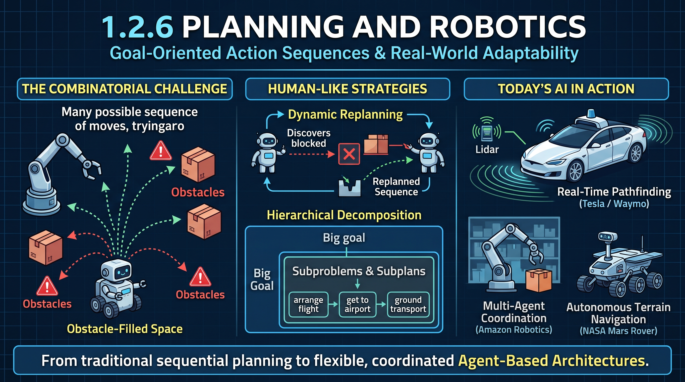
Planning and Robotics

Slide 34
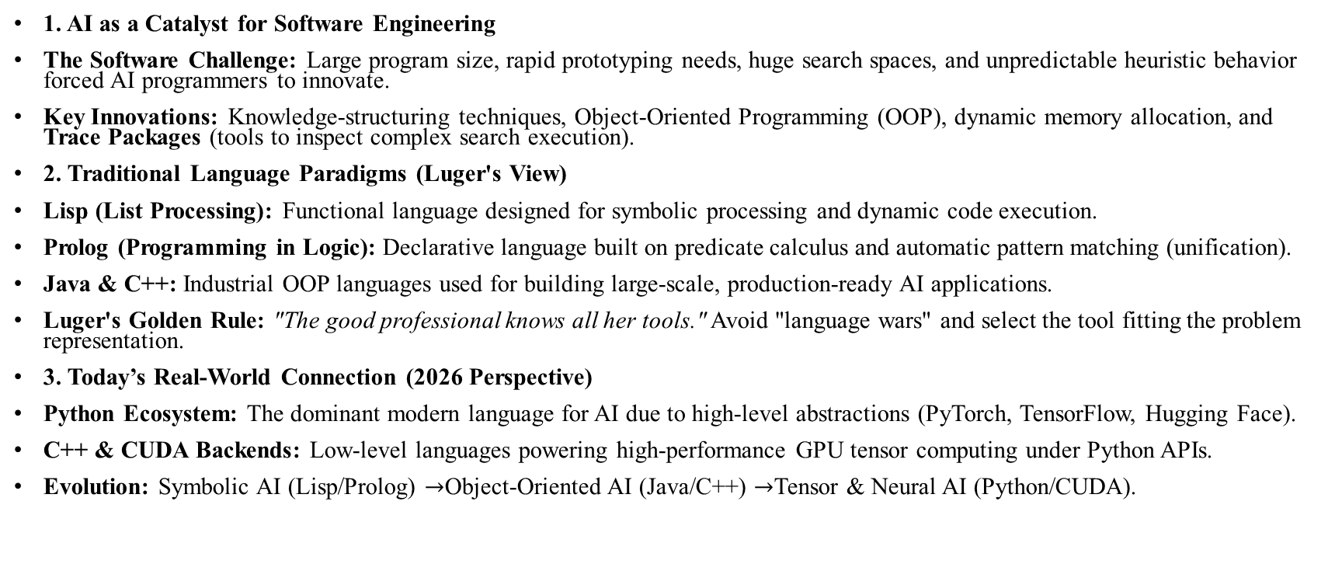
Languages and Environments for AI
1. AI as a Catalyst for Software Engineering
The Software Challenge: Large program size, rapid prototyping needs, huge search spaces, and unpredictable heuristic behavior forced AI programmers to innovate.
Key Innovations: Knowledge-structuring techniques, Object-Oriented Programming (OOP), dynamic memory allocation, and Trace Packages (tools to inspect complex search execution).
2. Traditional Language Paradigms (Luger's View)
Lisp (List Processing): Functional language designed for symbolic processing and dynamic code execution.
Prolog (Programming in Logic): Declarative language built on predicate calculus and automatic pattern matching (unification).
Java & C++: Industrial OOP languages used for building large-scale, production-ready AI applications.
Luger's Golden Rule: "The good professional knows all her tools." Avoid "language wars" and select the tool fitting the problem representation.
3. Today’s Real-World Connection (2026 Perspective)
Python Ecosystem: The dominant modern language for AI due to high-level abstractions (PyTorch, TensorFlow, Hugging Face).
C++ & CUDA Backends: Low-level languages powering high-performance GPU tensor computing under Python APIs.
Evolution: Symbolic AI (Lisp/Prolog) $→$Object-Oriented AI (Java/C++) $→$Tensor & Neural AI (Python/CUDA).

Slide 35
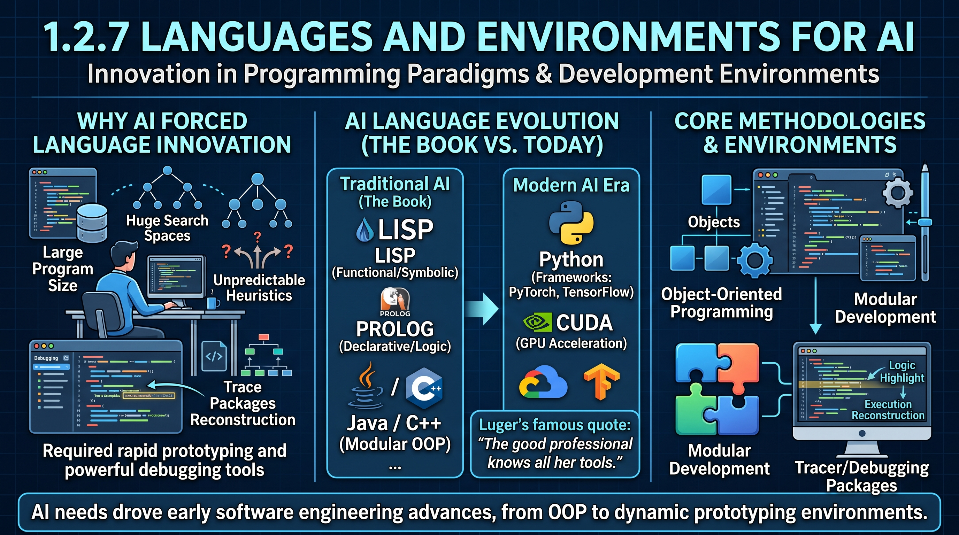
Languages and Environments for AI

Slide 36
Machine Learning
Section 1.2.8: Machine Learning
Course: Artificial Intelligence | Textbook: Artificial Intelligence by George F. Luger (Chapter 1)
1. The Core Problem & Motivation
Traditional Expert Systems:
  Perform extensive computations to solve complex problems.
  The Limitation: If given the exact same problem a second time, they do not remember the solution and repeat the same computations from scratch.
The Goal of Machine Learning:
  Build programs that learn autonomously from experience, analogies, examples, instructions, or reward/punishment feedback.

Slide 37
Machine Learning (Cont…)
2. Key Early Milestones in Machine Learning
AM — Automated Mathematician (Lenat 1977, 1982)
  Function: Discovered new mathematical laws and theorems.
  How it worked: Started with basic set theory axioms and used heuristics to induce concepts like cardinality, arithmetic, and number theory.
Concept Induction & ID3 (Winston 1975 / Quinlan 1986)
  Winston: Induced structural concepts (such as defining an "Arch") from visual blocks-world examples.
  ID3 Algorithm: Successfully extracted general decision patterns and classification rules from training data.
Meta-DENDRAL (Organic Chemistry)
  Function: Learned interpretation rules for mass spectrographic data.
  Impact: Showed that machine learning can automatically construct rules for expert systems from real-world scientific data.
3. Takeaway for Students
"Machine Learning transforms AI from static, rule-following programs into adaptive systems capable of general problem-solving in realistic domains."

Slide 38
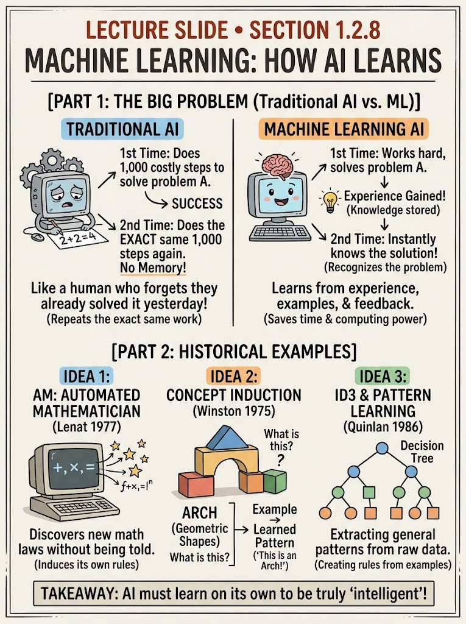

Slide 39
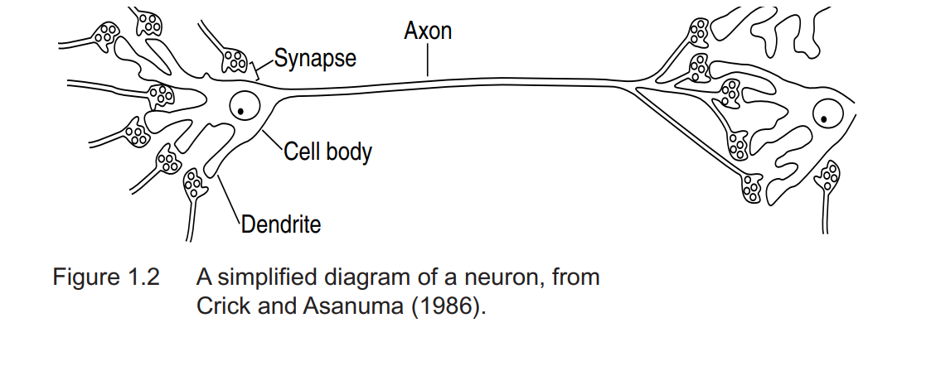
Alternative Representations: Neural Nets and Genetic Algorithms

Slide 40
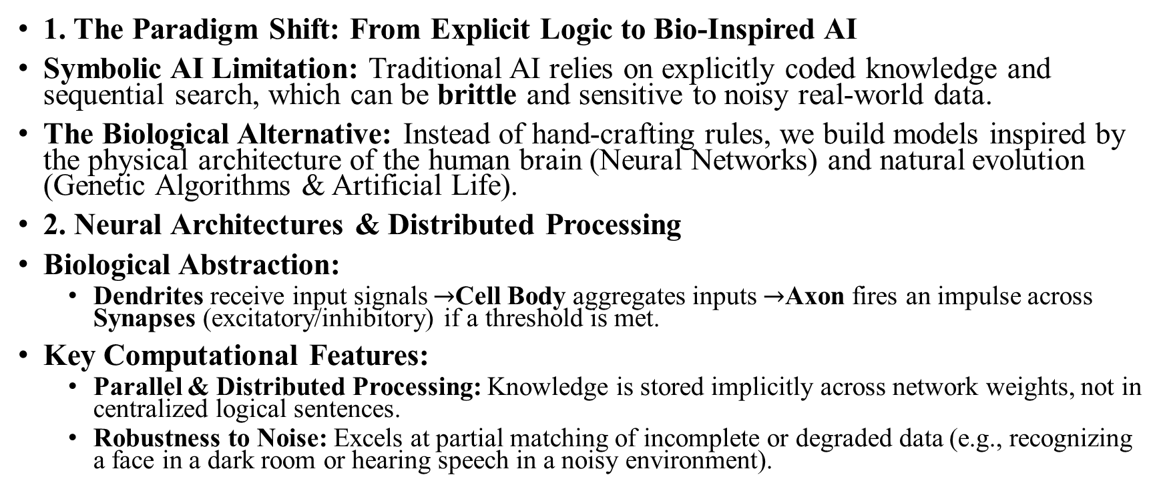
Alternative Representations: Neural Nets and Genetic Algorithms
1. The Paradigm Shift: From Explicit Logic to Bio-Inspired AI
Symbolic AI Limitation: Traditional AI relies on explicitly coded knowledge and sequential search, which can be brittle and sensitive to noisy real-world data.
The Biological Alternative: Instead of hand-crafting rules, we build models inspired by the physical architecture of the human brain (Neural Networks) and natural evolution (Genetic Algorithms & Artificial Life).
2. Neural Architectures & Distributed Processing
Biological Abstraction:
  Dendrites receive input signals $→$Cell Body aggregates inputs $→$Axon fires an impulse across Synapses (excitatory/inhibitory) if a threshold is met.
Key Computational Features:
  Parallel & Distributed Processing: Knowledge is stored implicitly across network weights, not in centralized logical sentences.
  Robustness to Noise: Excels at partial matching of incomplete or degraded data (e.g., recognizing a face in a dark room or hearing speech in a noisy environment).

Slide 41
Alternative Representations: Neural Nets and Genetic Algorithms
3. Evolutionary Computing & Massive Parallelism
Genetic Algorithms & Artificial Life:
  Candidate solutions are evolved across generations using biological operators: Crossover (recombining successful sub-solutions) and Mutation.
  Survival of the fittest: Fitness evaluation drives generations toward optimal problem-solving states.
Solving the "Search Slowdown" Paradox:
  Hillis (1985) Insight: Sequential computers slow down as knowledge bases grow; humans get faster.
  Massively parallel bio-inspired architectures process vast spaces concurrently, mirroring the very substrate that evolved human intelligence.
4. Modern Real-World AI Connection (2026 Perspective)
Deep Learning & LLMs: Modern Transformers (GPT-4o, Gemini) are massive expansions of these distributed neural representations.
Reinforcement Learning & Evolutionary AI: Used in robotics (Boston Dynamics) and hyperparameter optimization to "evolve" model architectures automatically.

Slide 42
AI and Philosophy
1. A Two-Way Intellectual Relationship
Reciprocal Contribution: AI is not merely a consumer of philosophy, mathematics, and logic; it active contributes back to these disciplines by testing foundational questions.
Core Philosophical Questions:
  What is intelligence, and how do we formalize knowledge?
  How does domain knowledge connect to problem-solving skill?
  How does knowing what is true (Theoria) relate to knowing how to perform (Praxis)?
2. AI Programs as Empirical Experiments
The Computational Laboratory: AI operationalizes philosophical theories into concrete code, running programs as experiments to test if representations and algorithms are sufficient for intelligent behavior.
The Physical Symbol System Hypothesis (Newell & Simon, 1976):
"A physical symbol system has the necessary and sufficient means for general intelligent action."
  Takeaway: Proposes that symbol manipulation alone is both necessary and adequate to produce physical intelligence.

Slide 43
AI and Philosophy
3. Deep Philosophical Questions in Application Domains
Natural Language & Semantics:
  Well-formed syntax is insufficient; true language comprehension requires imputing meaning and interpretation in context.
  Philosophical Inquiry: What constitutes "meaning"? Does genuine interpretation require intentionality or responsibility?
Broader Domain Ethics & Epistemology: Building expert systems, vision models, and machine learning algorithms forces us to re-examine perception, learning, and human-computer cooperation.
4. Modern AI Connection (2026 Perspective)
Beyond Pure Symbol Systems: Modern Large Language Models (LLMs) challenge Newell & Simon's hypothesis by generating rich, seemingly intelligent behaviors through high-dimensional statistical vectors rather than purely explicit symbolic rules.
AI Safety & Alignment: Questions regarding machine responsibility, interpretation, and moral agency are no longer just abstract philosophical debates—they are critical engineering requirements in today's frontier AI deployment.

Slide 44
Artificial Intelligence—A Summary
1. What Unifies the Field of AI?
Despite the wide diversity of applications (from medical diagnosis to autonomous vehicles), all AI systems share a core goal: automating intelligent problem-solving, planning, and communication.
2. The 8 Defining Features of AI Systems (Luger's Synthesis)
Inference & Pattern Recognition: Uses computational systems for reasoning, learning, and pattern matching rather than simple numerical calculations.
Heuristic Search: Targets ill-defined problems that lack direct, step-by-step algorithmic solutions.
Handling Uncertainty & Incompleteness: Operates effectively under conditions with missing, noisy, or inexact information.
Qualitative Reasoning: Focuses on reasoning about significant qualitative features rather than purely quantitative data.
Semantics Over Pure Syntax: Attempts to process underlying contextual meaning alongside formal structure.
"Sufficient" Solutions (Satisficing): Produces results that are good enough rather than mathematically optimal, acknowledging computational limits.
Domain-Specific Knowledge: Relies heavily on rich, specialized knowledge bases to tackle expert-level tasks.
Meta-Level Knowledge: Employs reasoning about reasoning (meta-knowledge) to control and adapt problem-solving strategies dynamically.

Slide 45
Artificial Intelligence—A Summary
3. The Big Picture: "The Pattern Which Connects"
"Break the pattern which connects the items of learning and you necessarily destroy all quality."
— Gregory Bateson (1979)
Connecting the Concepts: Isolated algorithms mean little on their own. Representation, search, logic, and heuristics gain true meaning only through their relationships within complete AI architectures.
4. Modern AI Connection (2026 Perspective)
Satisficing in Frontier Models: Modern Large Language Models and Reinforcement Learning agents embody Luger’s points—they trade exact mathematical guarantees for flexible, "sufficient" solutions under massive uncertainty.
Meta-Reasoning Today: Advanced agentic frameworks utilize meta-prompting and self-reflection loops to evaluate and correct their own step-by-step thinking.

Slide 46
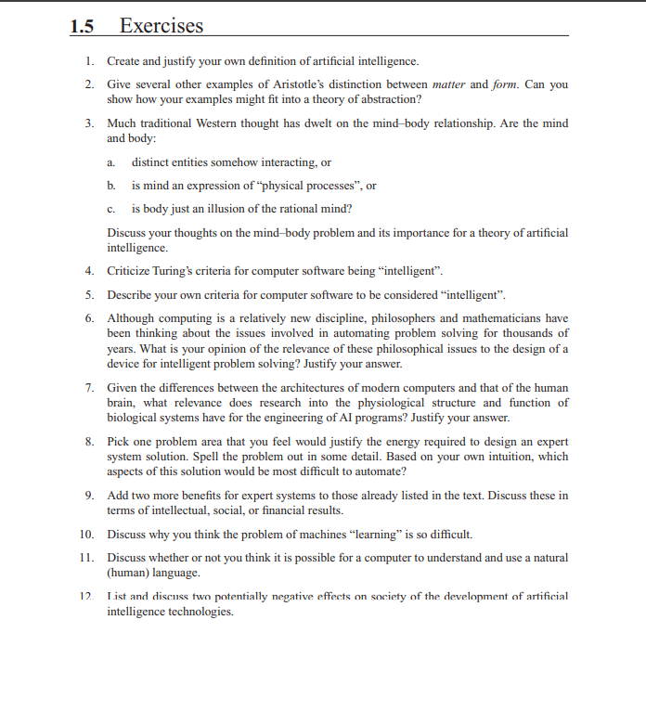
Practice For Exams (CLO-I)

